Slide 1



Serverless Computing: The Future of Application Development
Serverless computing is a cloud-based execution model that allows developers to run code without provisioning or managing servers.

Slide 2


Advantages of Serverless Computing
1
Cost Efficiency
Pay only for the resources used, eliminating idle server costs.
2
Scalability
Automatically scales up or down based on demand, ensuring optimal performance.
3
Focus on Code
Developers can focus on writing business logic, reducing infrastructure management overhead.
4
Faster Deployment
Deploy code quickly and easily, simplifying the deployment process.

Slide 3


Use Cases of Serverless Computing
API Development
Build scalable and cost-effective APIs for various applications.
Real-Time Data Processing
Process and analyze large volumes of data in real-time, such as streaming analytics.
Web and Mobile Backends
Power web and mobile applications with scalable and reliable back-end infrastructure.
Event-Driven Architectures
Develop applications that react to events, such as notifications, user actions, or data changes.

Slide 4
Serverless Computing Platforms
AWS Lambda
Azure Functions
Google Cloud Functions
Serverless compute service from Amazon Web Services.
Serverless compute service from Microsoft Azure.
Serverless compute service from Google Cloud Platform.

Slide 5


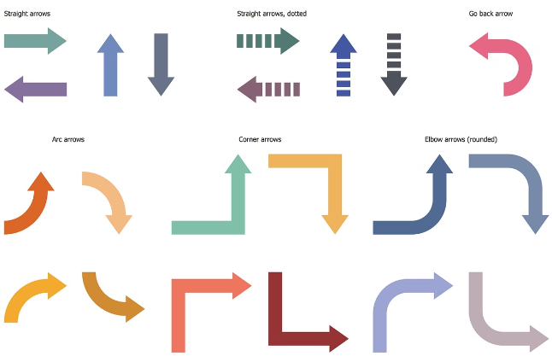


Serverless Architecture Patterns
Event-Driven
Triggered by events, such as user actions or data changes.
Microservices
Break down applications into small, independent services.
API Gateway
Centralized entry point for managing API requests and authorization.

Slide 6


Serverless Deployment Strategies
1
Continuous Integration/Continuous Delivery (CI/CD)
Automate the build, test, and deployment process.
2
Infrastructure as Code (IaC)
Define and manage infrastructure using code for consistency and repeatability.
3
Serverless Frameworks
Simplify serverless application development with pre-built tools and templates.

Slide 7

Serverless Security Considerations
Authentication and Authorization
Secure user access and control resource permissions.
Data Encryption
Protect sensitive data at rest and in transit.
Vulnerability Management
Regularly scan for and patch vulnerabilities.

Slide 8
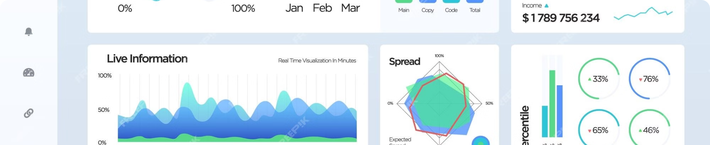




Serverless Monitoring and Observability
Log Monitoring
Metrics Collection
Tracing
Alerting
Track and analyze application logs for insights and troubleshooting.
Collect performance metrics, such as CPU utilization and response times.
Track the flow of requests through the application for performance optimization.
Set up alerts for critical events or anomalies.

Slide 9


Pseudo Code for Serverless Application
function handleRequest(event) { // Process the event data let response = { statusCode: 200, body: JSON.stringify(processedData) }; return response; } // Trigger the function on a specific event exports.handler = handleRequest;

